Slide 1

Structured Query Language - I
Gerry Guinane
Limerick Institute of Technology
SQL Lecture 01

Slide 2
Learning outcomes
Learning outcomes – the student will be able to
Identify each part of the SELECT syntax definition.
Use the SQL SELECT statement based on the syntax definition.

Slide 3
SELECT Statement
Instructs the DBMS to return information from the database as a set of records.

Slide 4
Syntax (MS Access)
SELECT [predicate]
{ * | table.* | [table.]field1 [AS alias1] [, [table.]field2 [AS alias2] [, ...]]}
FROM tableexpression [, ...] [IN externaldatabase]
[WHERE... ]
[GROUP BY... ]
[HAVING... ]
[ORDER BY... ]

Slide 5
Syntax (MySQL)
SELECT [predicate]
select_expr, ...
[FROM table_references
[WHERE where_condition]
[GROUP BY {col_name | expr | position}
[ASC | DESC], ... [WITH ROLLUP]]
[HAVING where_condition]
[ORDER BY {col_name | expr | position}
[ASC | DESC], ...]
[LIMIT {[offset,] row_count | row_count OFFSET offset}]
[PROCEDURE procedure_name(argument_list)]
[INTO OUTFILE 'file_name' export_options
| INTO DUMPFILE 'file_name'
| INTO var_name [, var_name]]
[FOR UPDATE | LOCK IN SHARE MODE]]
☺
Notes:
SELECT
[ALL | DISTINCT | DISTINCTROW ]
[HIGH_PRIORITY]
[STRAIGHT_JOIN]
[SQL_SMALL_RESULT] [SQL_BIG_RESULT] [SQL_BUFFER_RESULT]
[SQL_CACHE | SQL_NO_CACHE] [SQL_CALC_FOUND_ROWS]
select_expr, ...
[FROM table_references
[WHERE where_condition]
[GROUP BY {col_name | expr | position}
[ASC | DESC], ... [WITH ROLLUP]]
[HAVING where_condition]
[ORDER BY {col_name | expr | position}
[ASC | DESC], ...]
[LIMIT {[offset,] row_count | row_count OFFSET offset}]
[PROCEDURE procedure_name(argument_list)]
[INTO OUTFILE 'file_name' export_options
| INTO DUMPFILE 'file_name'
| INTO var_name [, var_name]]
[FOR UPDATE | LOCK IN SHARE MODE]]

Slide 6
Syntax Parts
Part Description.
Predicate One of the following predicates: ALL, DISTINCT, DISTINCTROW, or TOP. You use the predicate to restrict the number of records returned. If none is specified, the default is ALL.
* Specifies that all fields from the specified table or tables are selected.
Table The name of the table containing the fields from which records are selected.
field1, field2 The names of the fields containing the data you want to retrieve. If you include more than one field, they are retrieved in the order listed.

Slide 7
Syntax Parts
alias1, alias2 The names to use as column headers instead of the original column names in table.
Tableexpression The name of the table or tables containing the data you want to retrieve.
Externaldatabase The name of the database containing the tables in tableexpression if they are not in the current database.

Slide 8
Break Down the Syntax
SELECT [predicate] { * | table.* | [table.]field1 [AS alias1] [, [table.]field2 [AS alias2] [, ...]]} FROM tableexpression [, ...] [IN externaldatabase] [WHERE... ] [GROUP BY... ] [HAVING... ] [ORDER BY... ] [WITH OWNERACCESS OPTION]
Focus on the bit in RED
This bit defines WHAT gets selected.

Slide 9
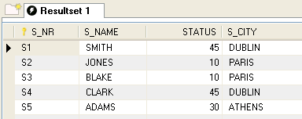
SELECT Example 1
Query
Result
SELECT *
FROM suppliers;
SELECT suppliers.*
FROM suppliers;
Notes
These queries are equally valid versus Syntax definition.
The * acts as a wild card character
Tableexpression is suppliers
This query selects all attributes from table S using a wild card * or table.*

Slide 10
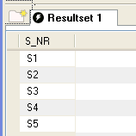
SELECT Example 2
Query
Result
SELECT SUPPLIERS.S_NR
FROM SUPPLIERS;
Notes
This query selects a single attribute from table S using syntax:
SELECT [table.]field1
FROM Tableexpression

Slide 11
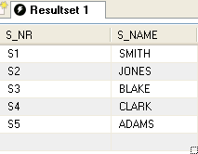
SELECT Example 3
Query
Result
SELECT SUPPLIERS.S_NR,SUPPLIERS.S_NAME FROM SUPPLIERS;
Notes
This query selects 2 attributes from table S using syntax:
SELECT [table.]field1, [table.]field2
FROM Tableexpression

Slide 12
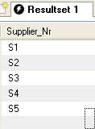
SELECT Example 4
Query
Result
SELECT SUPPLIERS.S_NR
AS Supplier_Nr
FROM SUPPLIERS;
Notes
1. This query selects 1 attribute from table S using syntax:
SELECT [table.]field1 AS alias1
FROM Tableexpression

Slide 13
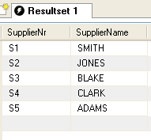
SELECT Example 5
Query
Result
SELECT
SUPPLIERS.S_NR AS SupplierNr,
SUPPLIERS.S_NAME AS SupplierName
FROM SUPPLIERS;
Notes
1. This query selects 2 attributes from table S using syntax:
SELECT [table.]field1 AS alias1,
[table.]field2 AS alias2
FROM Tableexpression

Slide 14
Predicates
SELECT [predicate] { * | table.* | [table.]field1 [AS alias1] [, [table.]field2 [AS alias2] [, ...]]}
There are 4 predicates to choose from which help to limit the number of rows returned in a query:
The ALL and DISTINCT modifiers specify whether duplicate rows should be returned
ALL – Selects all the rows that meet the conditions specified in the query. ALL is assumed as the default if no predicate is specified.
DISTINCT or DISTINCTROW - Omits data based on entire duplicate rows. Duplicate rows are not possible in a relation but may come about as result of a query or join operation.
TOP n - Returns a certain number of records that fall at the top or the bottom of a range specified by an ORDER BY clause.

Slide 15
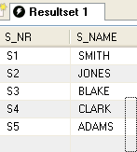
SELECT Example 6
Query
Result
SELECT ALL SUPPLIERS.S_NR, SUPPLIERS.SNAME
FROM SUPPLIERS;
Notes
This query selects 2 attributes from table S using syntax:
SELECT [PREDICATE] [table.]field1, [table.]field2
FROM Tableexpression
2. The ‘ALL’ predicate is assumed. This is exactly equivalent to Example 3 in which ALL is omitted.

Slide 16
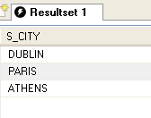
SELECT Example 7
Query
Result
SELECT DISTINCT SUPPLIERS.S_CITY
FROM SUPPLIERS;
Notes
1. This query selects 1 attribute from table S using syntax:
SELECT [PREDICATE] [table.]field1 FROM Tableexpression
2. The DISTINCT predicate only DISTINCT values from the selected attribute – duplicates are ignored.

Slide 17
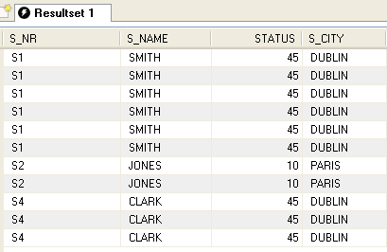
SELECT Example 9
Result
Query
SELECT SUPPLIERS.*
FROM SUPPLIERS INNER JOIN AVAILABLE_PARTS ON SUPPLIERS.S_NR = AVAILABLE_PARTS.SUPPLIER_NR;
Notes
1. This query has duplicate rows as result of a join between tables SUPPLIERS JOIN AVAILABLE_PARTS

Slide 18
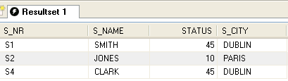
SELECT Example 9 - contd
Query
Result
SELECT DISTINCTROW SUPPLIERS.*
FROM SUPPLIERS INNER JOIN AVAILABLE_PARTS ON SUPPLIERS.S_NR = AVAILABLE_PARTS.SUPPLIER_NR;
Notes
1. This query selects a set of attributes from table SUPPLIERS JOIN AVAILABLE_PARTS using syntax:
SELECT [PREDICATE][table.]field1 FROM Tableexpression
2. Using the “DISTINCTROW” predicate this query returns only distinct rows – eliminating duplicates

Slide 19
Top n
Top n predicate is not implemented in MySQL
An alternative is to use a LIMIT sub-clause
SELECT *
FROM suppliers
ORDER BY STATUS DESC
LIMIT 3;
S1 | SMITH | 45 | DUBLIN
S4 | CLARK | 45 | DUBLIN
S5 | ADAMS | 30 | ATHENS

Slide 20
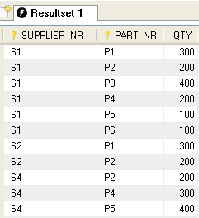
Exercise
Based on this table write SQL queries
To select all attributes
To select PART_NR and Qty
To Select PART_NR and SUPPLIER_NR, changing the headings to Part_No and Supp_No respectively
What is the difference between
SELECT * FROM available_parts;
SELECT ALL SUPPLIER_NR,PART_NR FROM available_parts;
What is the difference between
SELECT SUPPLIER_NR FROM available_parts;
SELECT DISTINCT SUPPLIER_NR From available_parts;

